Slide 1
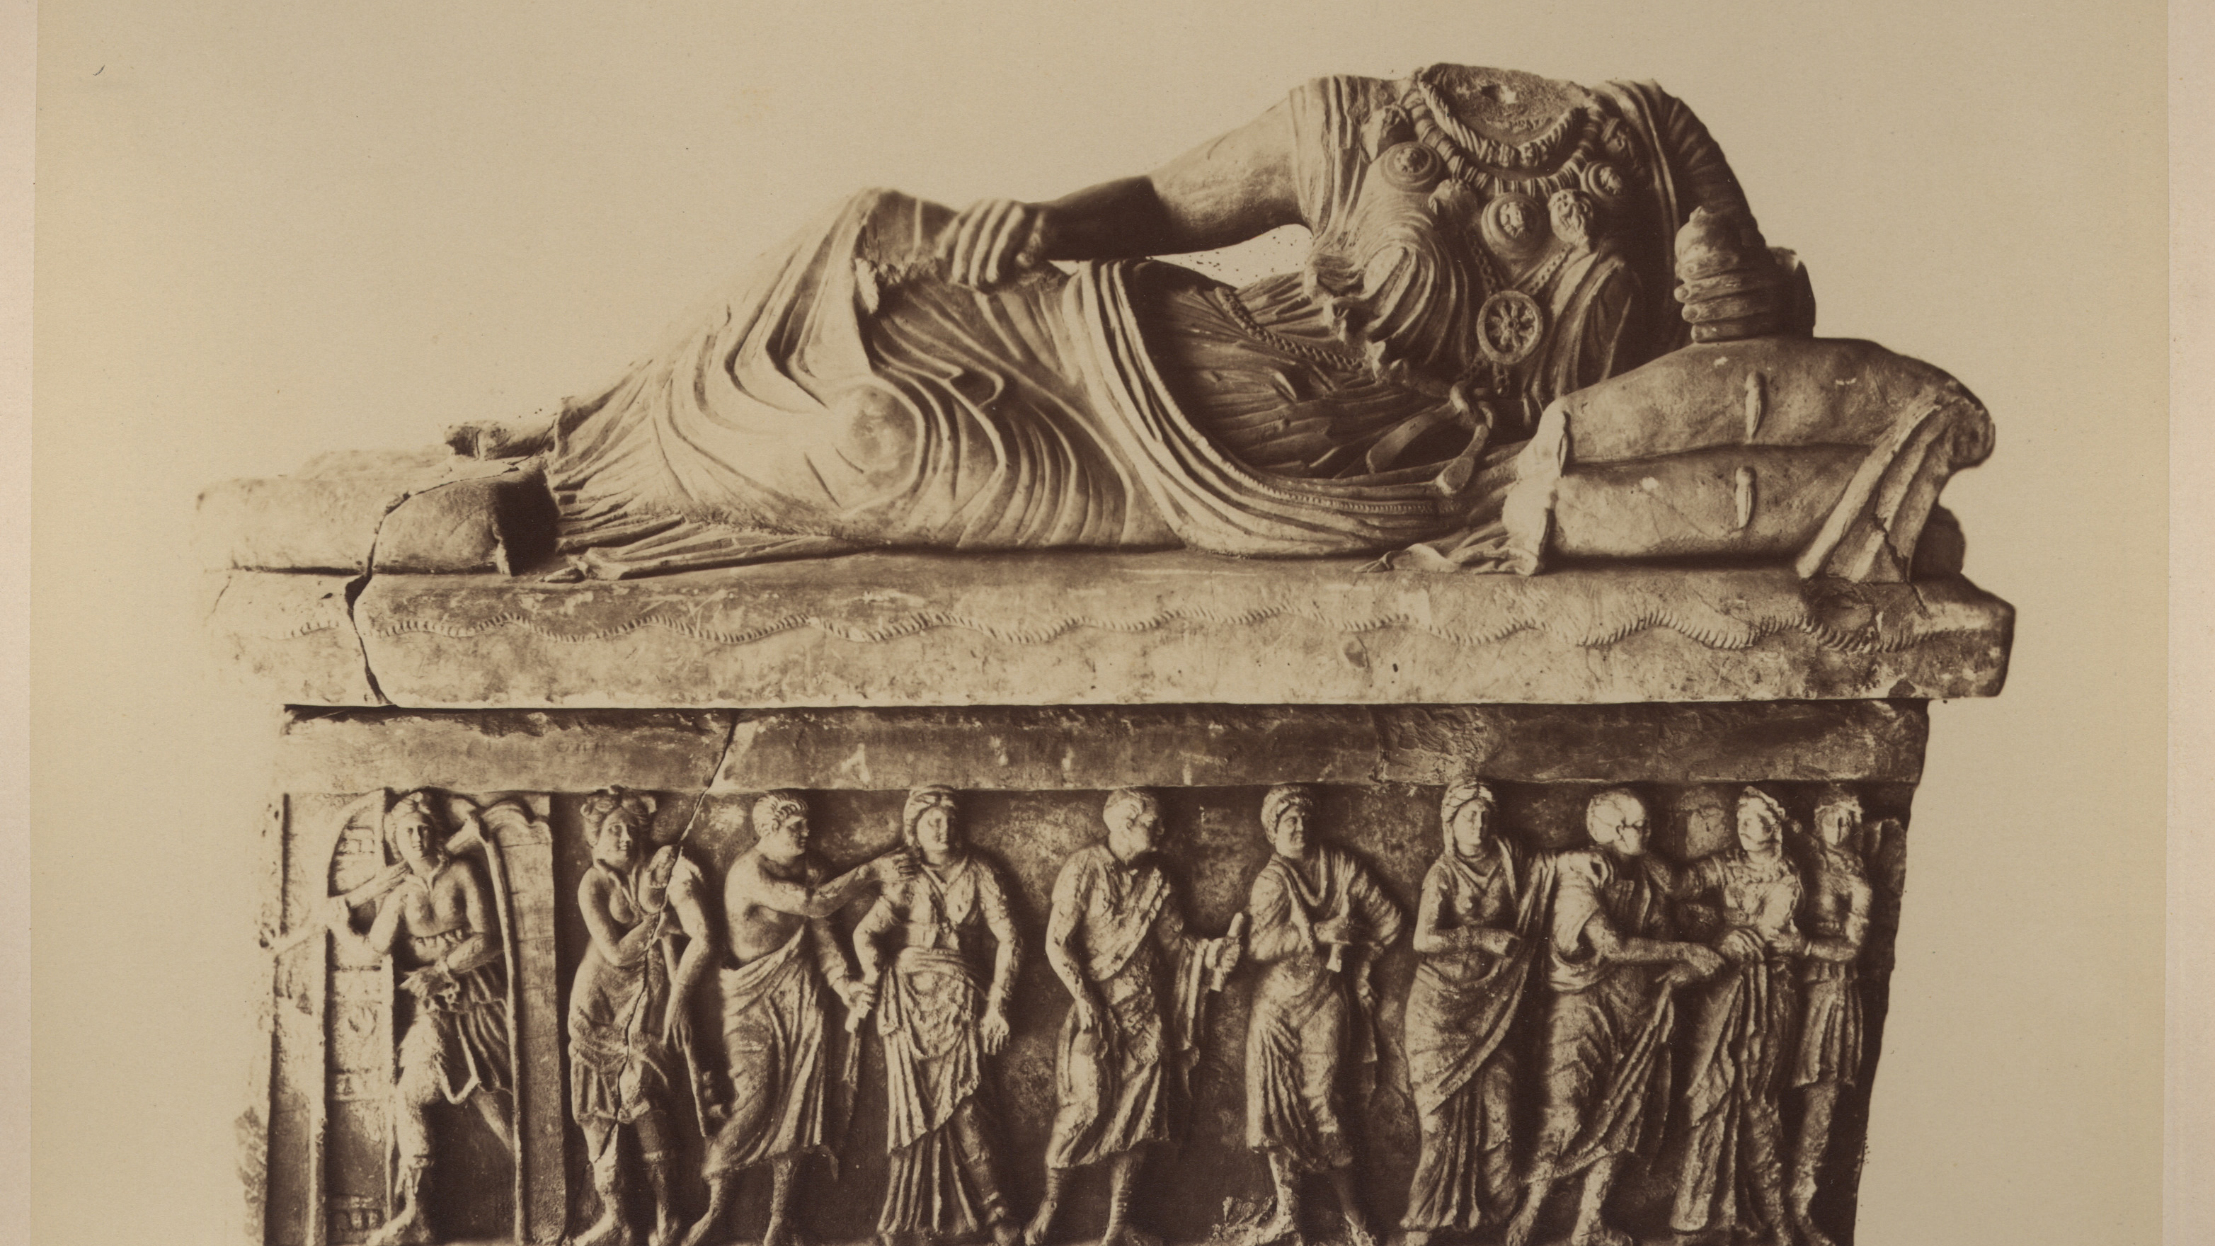
Partizione Antica
Looking for a XIXth century art historian
Enrica Zani – matr. 1004696
EPDS - DHDK master degree – a.a.2021-22

Slide 2
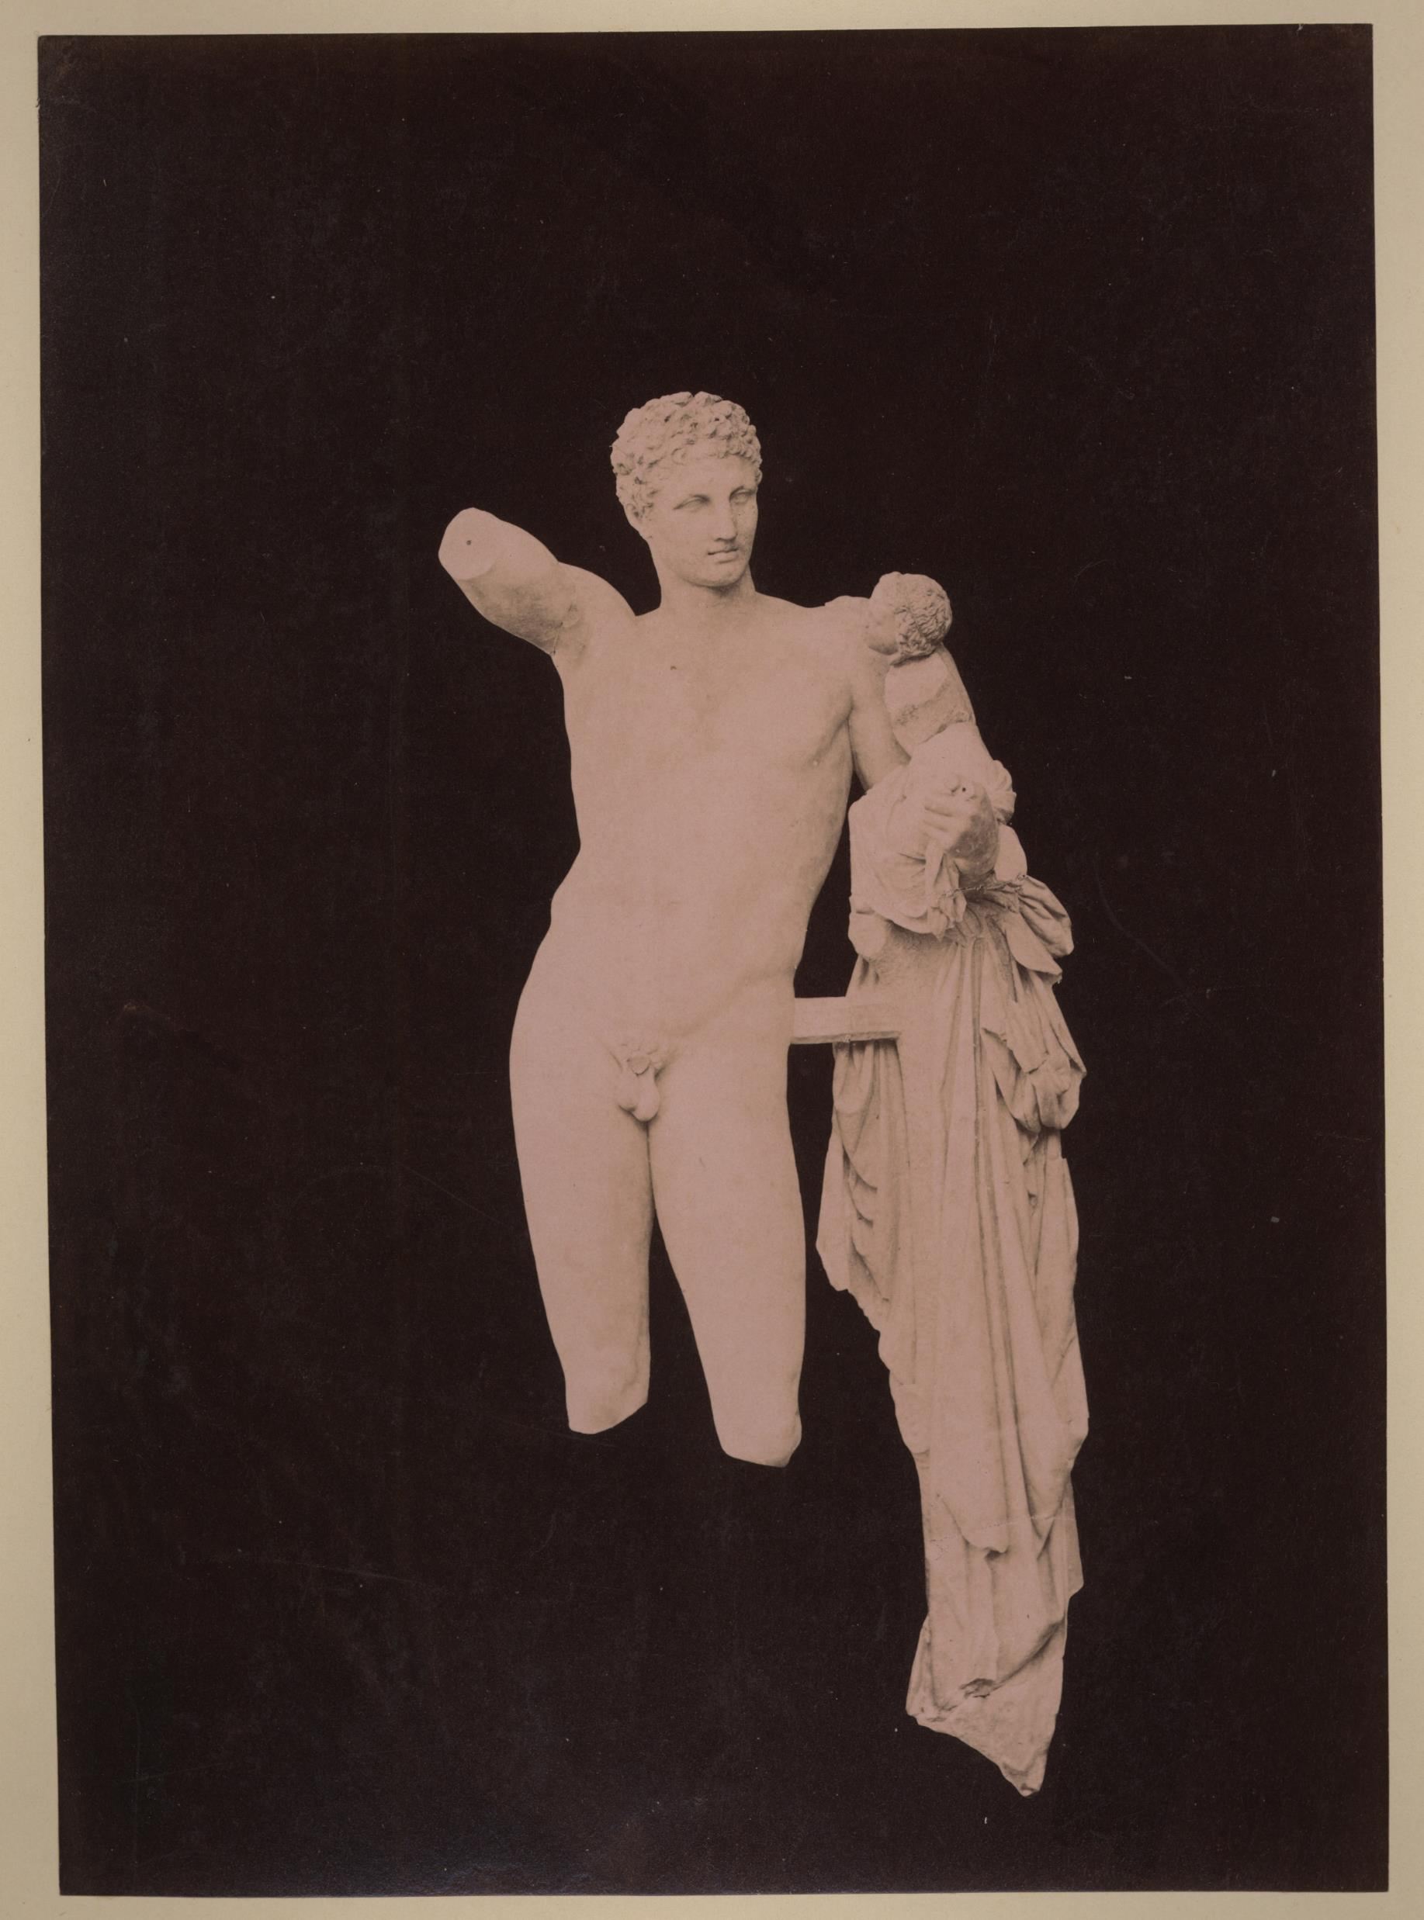
Background
The «Partizione Antica» is a special part of the whole Fototeca Supino archive, counting about 3000 photographs (over a total of 8000)
The photographic fund is specialized in History of Art
The photographs often have handwritten annotations on the verso from the same hand
The fund has already been studied and treated in the past
The fund is accessible from the Zeri Fundation catalogue
But the original collector identity remains unknown

Slide 3
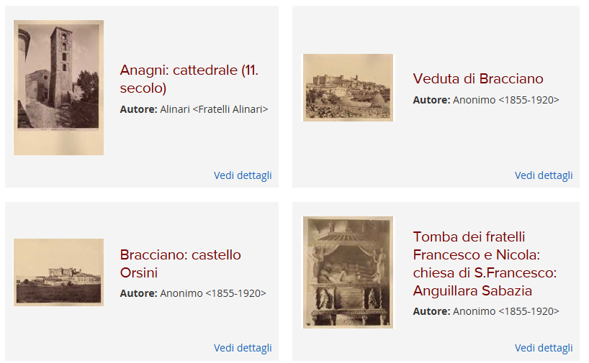
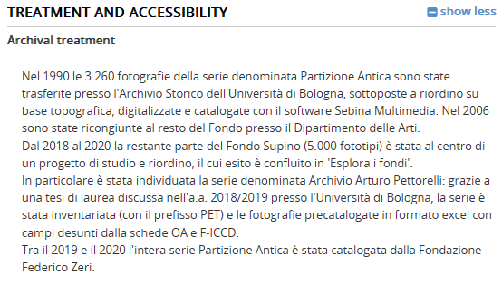
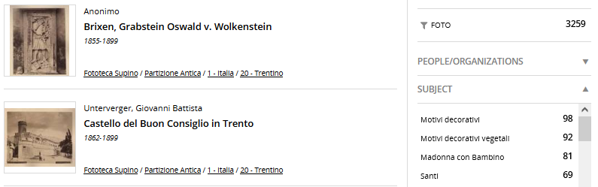
Goals
Using the “looking for …” story to offer to Zeri catalogue’s users:
an overall understanding of the fund beyond hierarchical metadata or texts
Improve informative value from existing data by means of data analysis and visualization
Launch new tracks to investigate the fund

Slide 4
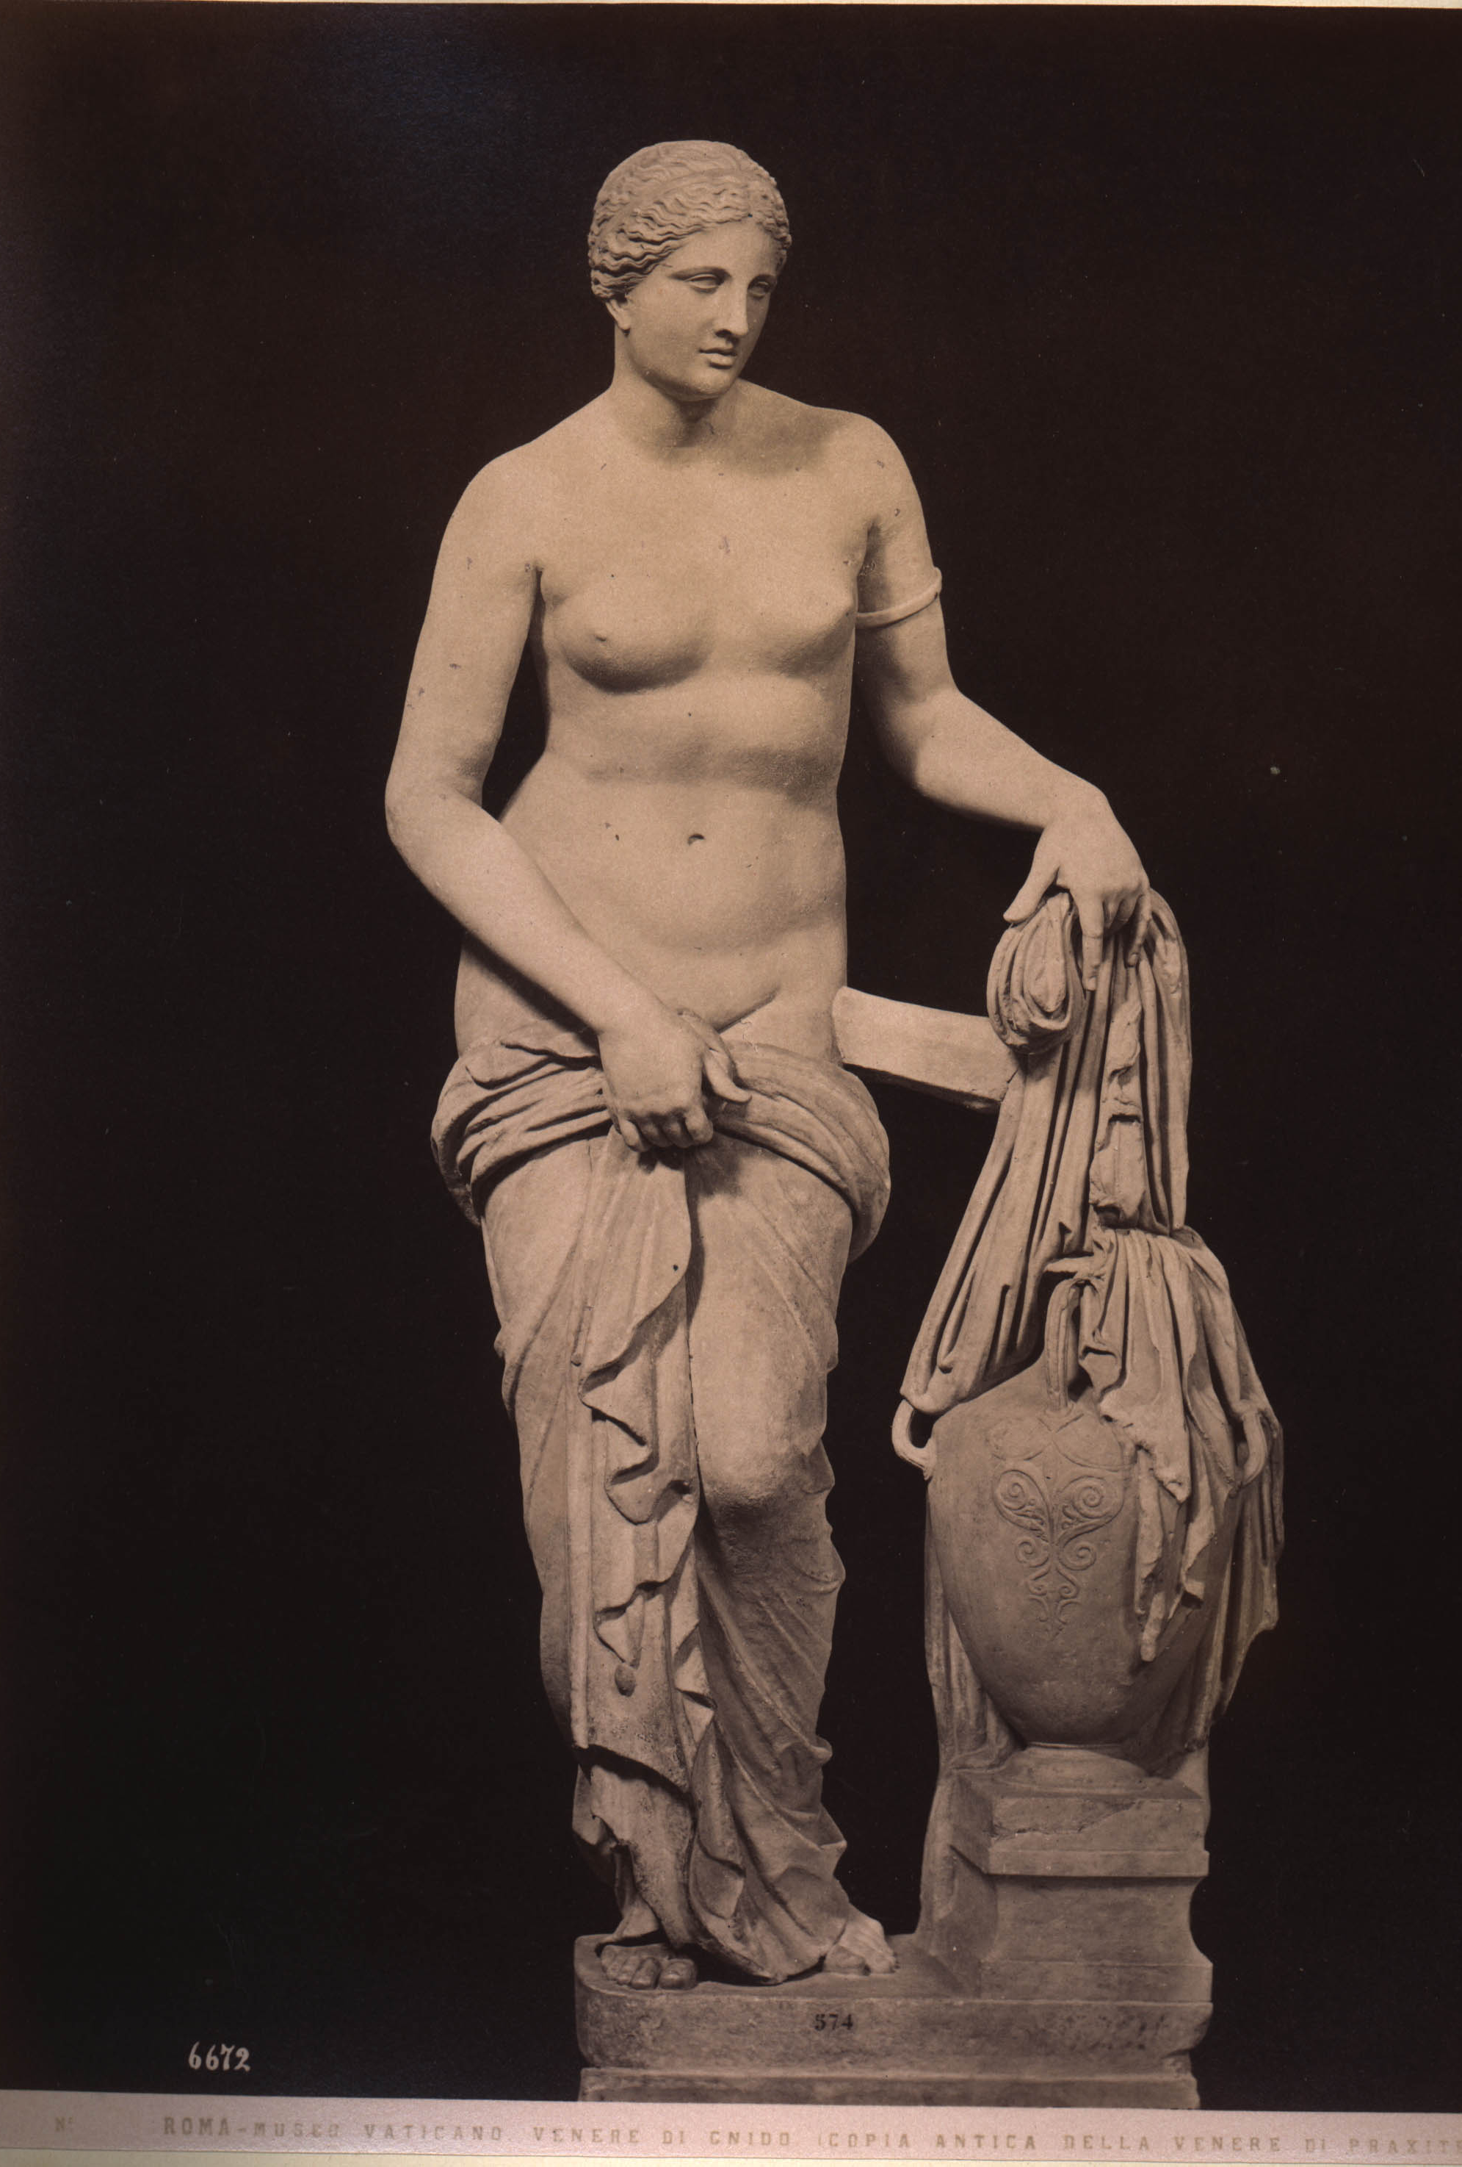
Research question
Who is the art historian creating the “Partizione Antica”?

Slide 5
Research question(s)
WORKs OF ART (interests and movements)
What are the most represented work of art types in the fund?
Where these works of art are located?
PHOTOGRAPHERs (contacts and movements)
Who are the most used photographers?
Where have the anonymous photos been shot?

Slide 6
Research question(s)
ANNOTATIONs (other infos)
How many photos have been annotated?
Does the annotation distribution vary according to depicted work of art century?
Can further personal or professional details be detected?
Is her/his presence attested somewhere and dated?

Slide 7
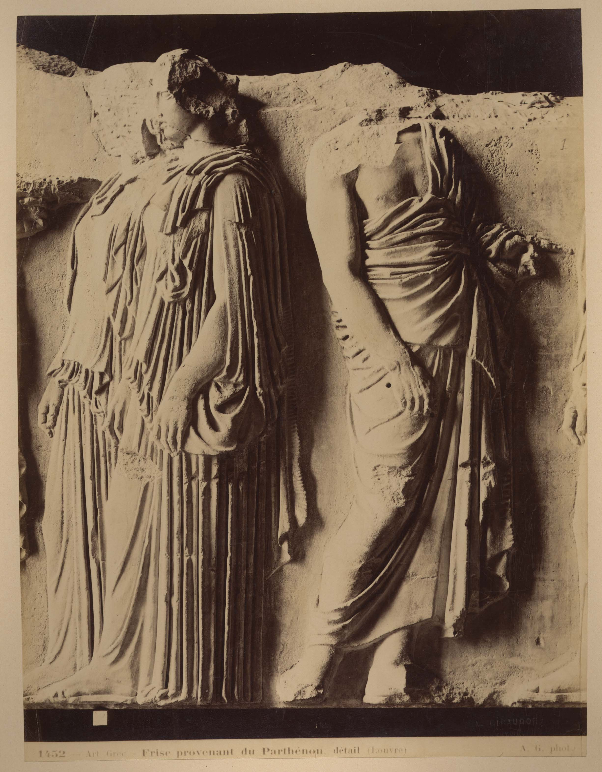
Data preparation and data analysis
Structured metadata come from an extraction of F and OA xml records of the Zeri catalogue
Unstructured data (transcribed annotations) have been extracted from a specific field of OA structured metadata
Further data about photographers’ activity dates and location have been explored via Wikidata
Data on geolocation have been added via geopy
Unstructured annotations have been analysed with spacy
In some cases, manual intervention has been necessary

Slide 8
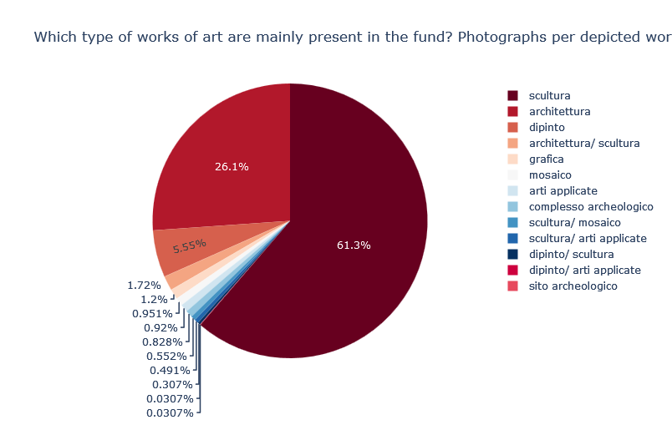
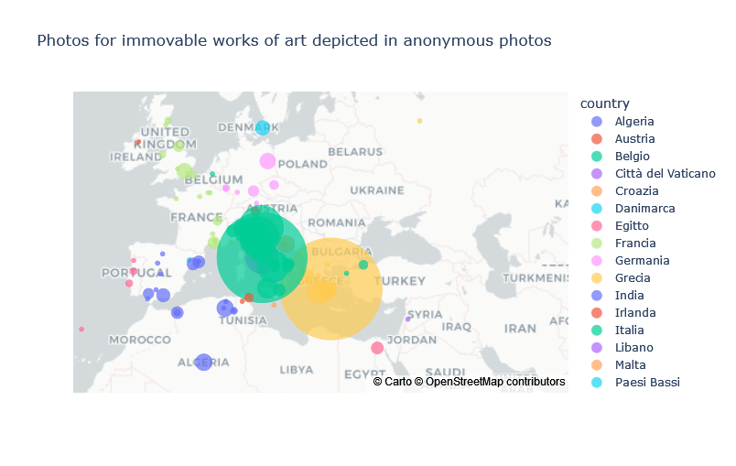
Data visualisations selected and reasons
Percentages on the total of photographs are shown in pie charts to grasp an overall idea
Quantities related to geographic features are offered with map visualizations showing:
city (position)
country (color)
count (size)

Slide 9
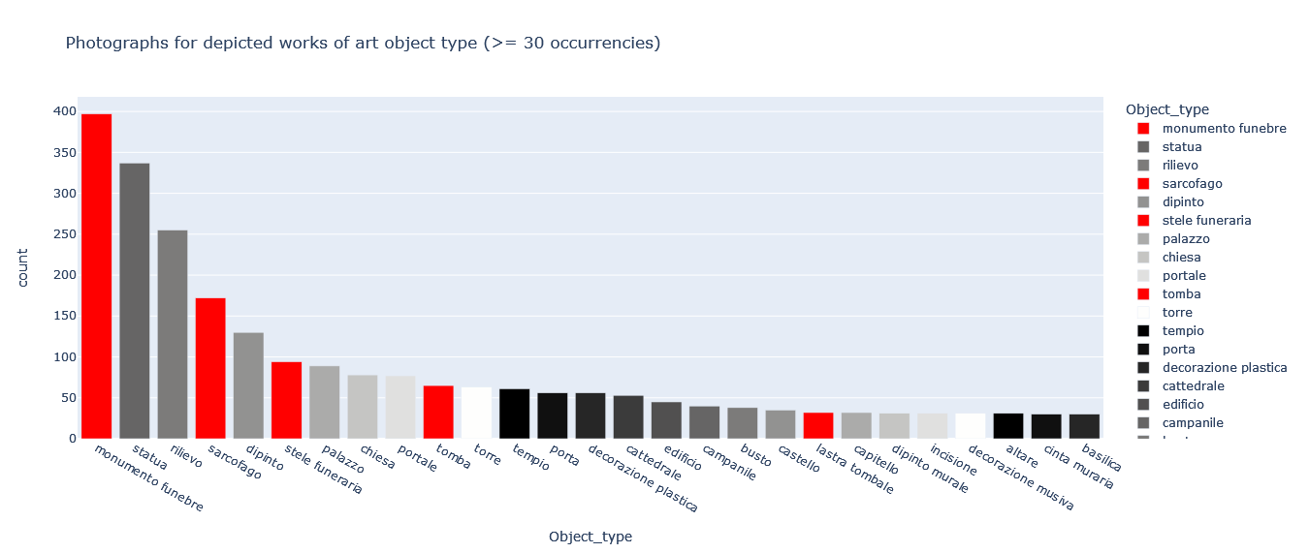
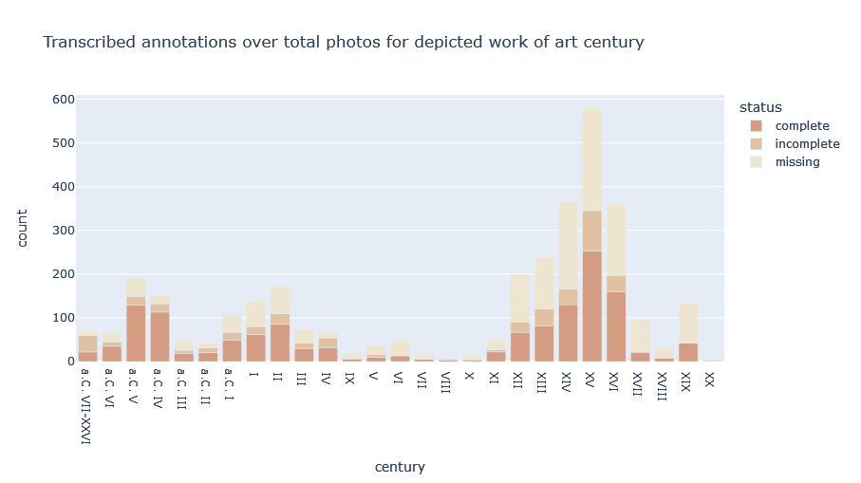
Data visualisations selected and reasons
Distributions of categorical values are shown as bar charts
if a/some category/ies need to be outlined, it/they received different colour
if more than a variable is involved, the one than can be grouped is shown stacked
If ordinality make sense (e.g. grade of completion) colour scale is used

Slide 10
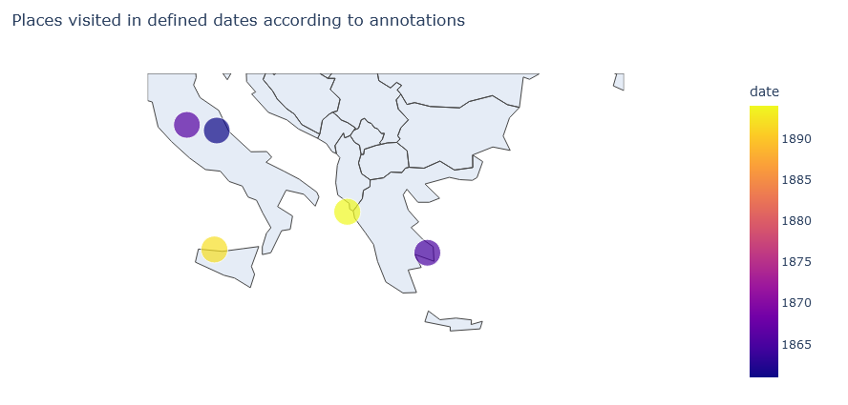
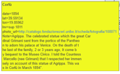
Data visualisations selected and reasons
More complex data
such as the combination of:
place-time pairs occurrences
annotations’ texts
link to photograph records
are shown in a map together with colour valorisation of time and adding information in the mouseover

Slide 11
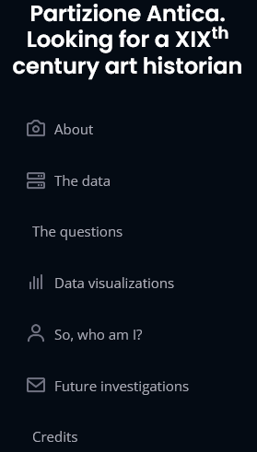
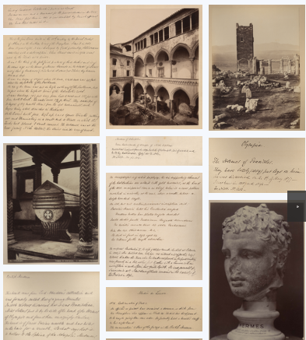
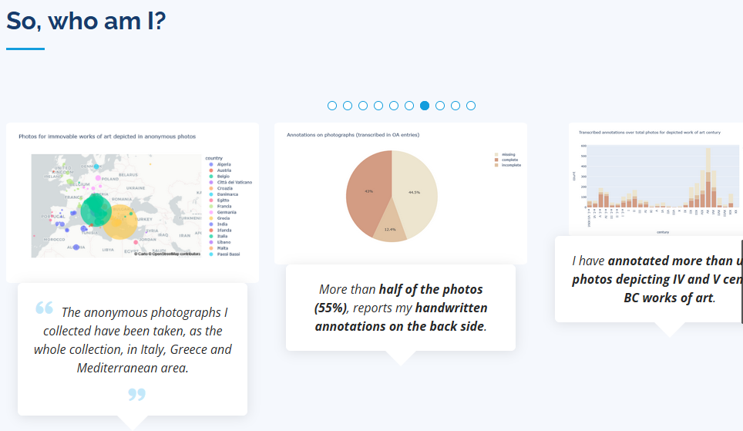
Data communication strategies
Target: Zeri catalogue users
specialized or curious in art
need for quick overview to check if going on with investigation on the fund
really linear sequential narration completed with images
The research question are mainly faced by steps:
an introductory frequency visualization
a deeper analysis on a subcategory
a translation in map visualization if geodata are involved in the previous point
The summary results of the investigation are offered trough a carousel of statements-charts pairs, from the “voice” of the unknown art historian
A call for action for future investigation conclude the path

Slide 12
Summary of results
Unexpected results that can be used for further investigations
Results confirming already known information
The “unknown collector” was interested in funerary sculpture and sarcophagus.
He/she has also an extra-European interest about India (18 photographs)
The “unknown collector” was interested in Mediterranean area
Places of shooting of anonymous photos do not show significant differences from the general collection
She/he was provided of photos from several minor named photographers (less than 20 photos each)
The number of annotations is higher on photos depicting IV-V BC. works of art, confirming her/his interest in ancient art.
NER related to dates confirm their activity in the second half of XIXth century
It has been possible to detect 6 place-time pairs attesting their presence movements.

Slide 13
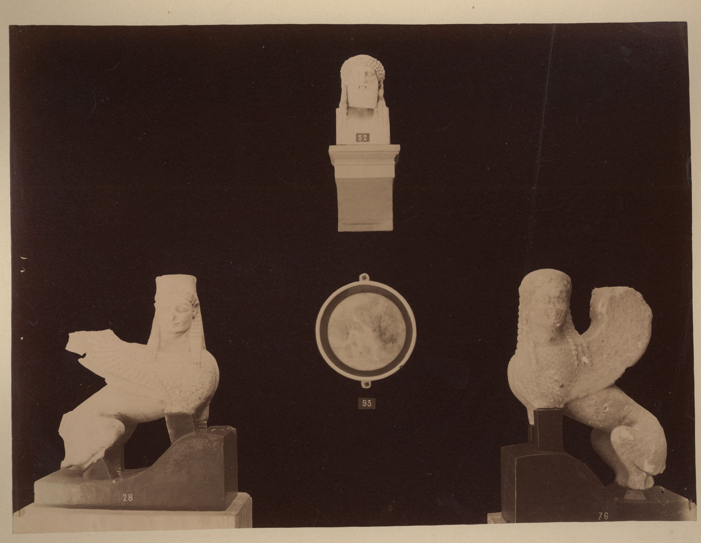
Thank you!
Let’s explore
Zani, E. (2023). Partizione Antica. Looking for a XIXth century art historian. https://github.com/enri-ca/EPDS_EZ
https://enri-ca.github.io/EPDS_EZ

